Slide 1

INT441 : industry internship project
Heart disease prediction on biometric data
Presented By:
Pravesh kumar , Satyanand kumar ,Gautam kumar, Sahil raj

Slide 2
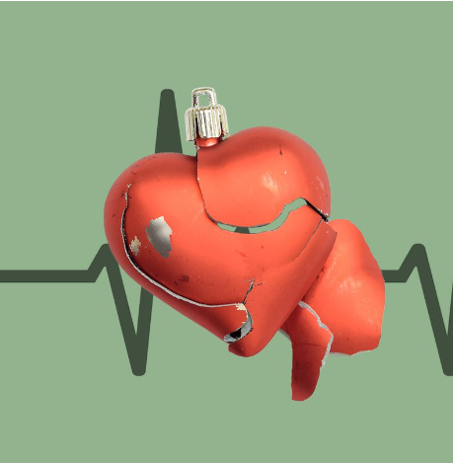
Abstract
In today’s era , the cases of heart disease are increasing at rapid rate . Blood pressure imbalance and high cholesterol is a leading causse of heart disease
We prepared a heart disease prediction system to predict whether the patient is likely to be diagnosed with a heart disease or not using the medical history of the patient electronic data.
We are going to use different maching learing algorithm like logistic regression, Random Forest (RF) and KNN to predict and classify the patient with heart disease.

Slide 3
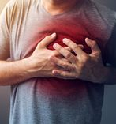
Introduction
Heart diseaseis a leading cause of death worldwide, and there is a need for accurate prediction models to identify individuals at high risk of developing heart disease. Machine learning algorithms have been shown to be effective in predicting heart disease risk, and Python provides a powerful platform for building and training these models.

Slide 4
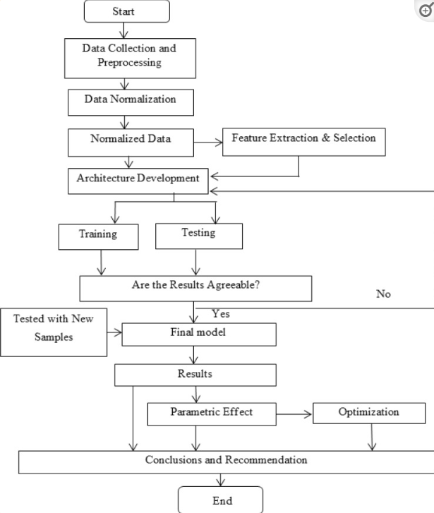
Flowchart

Slide 5





Libraries used
Panda
seaborn
Matplotlib.pyplot
Sklearn.svm
Numpy
Sklearn.linear_model
Sklearn.neighbors
Sklearn.ensemble
Sklearn.metrics
Plotly.express

Slide 6
• Cigs Per Day: the number of cigarettes that the person smoked on average in one day. • BP Meds: whether or not the patient was on blood pressure medication (Nominal) • Prevalent Stroke: whether or not the patient had previously had a stroke (Nominal) • Prevalent Hyp: whether or not the patient was hypertensive (Nominal) • Diabetes: whether or not the patient had diabetes (Nominal) • Tot Chol: total cholesterol level (Continuous) • Sys BP: systolic blood pressure (Continuous) • Dia BP: diastolic blood pressure (Continuous) • BMI: Body Mass Index (Continuous) • 10 year risk of coronary heart disease CHD(binary: “1”, means “Yes”, “0” means “No”)
Attribute Information

Slide 7
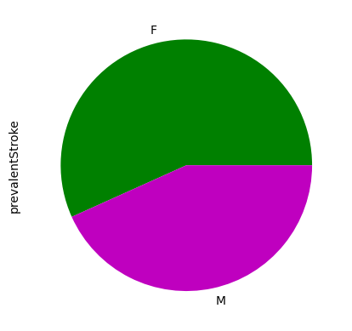
Pie Plot of prevalent stroke

Slide 8
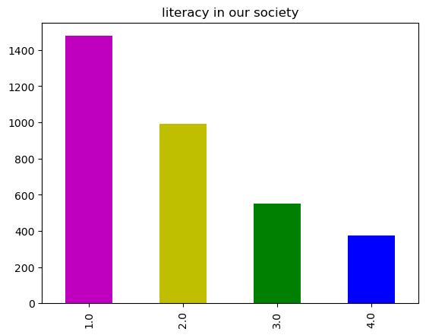
Bar Graph of literacy in our society

Slide 9
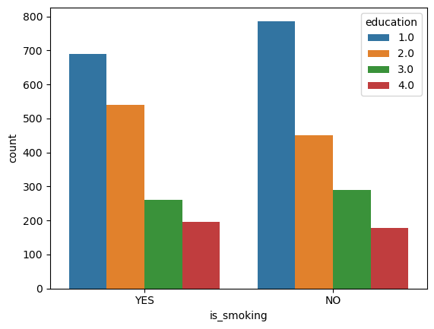
Bar chart that shows how many people who smoke are educated and how many are not educated.

Slide 10
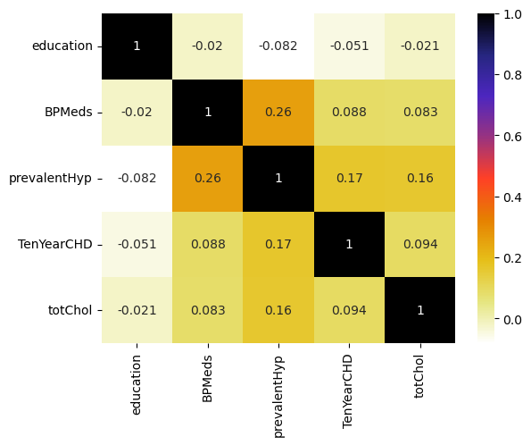
This is the correlation between few features.
Heat map

Slide 11
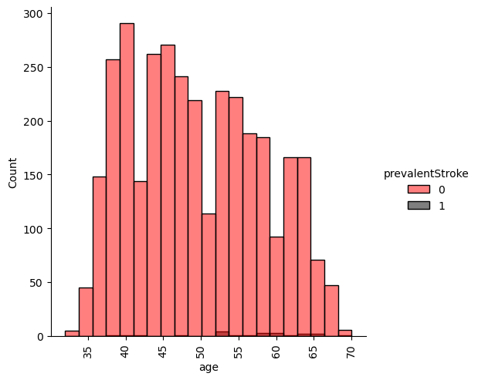
How age and prevalentstroke is releated to each other
Distribution plot

Slide 12
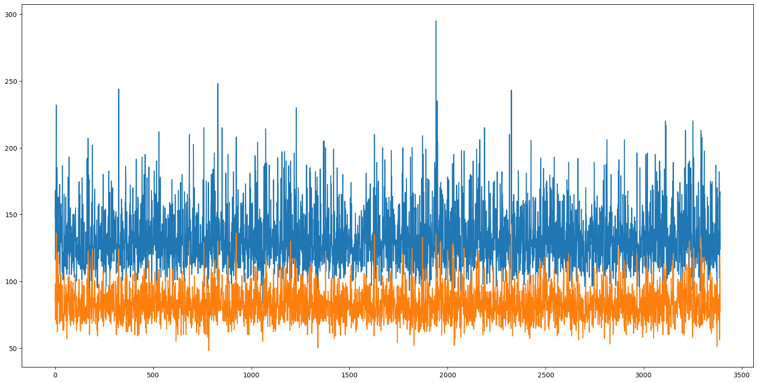
Line plot
From above stats i can conclude that very less people have normal blood pressure
and most people high blood presure or low blood presure

Slide 13
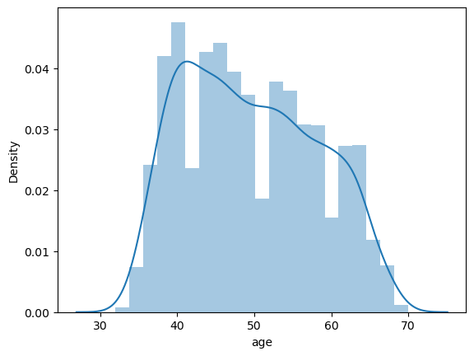
The graph is not normally distributed which means (40 to 50 age people are more)
Distribution plot

Slide 14
Thank you

